Slide 1
ADVANCED PROGRAMMING-ITIC 2223
Lecture 04- Python Operators
Ramesh Madhuranga
MPhil.(Reading) (USJP), BICT (Hons) (RUSL), AMCSSL
Department of Biosystems Technology
Faculty of Technology
Kotelawala Defence University

Slide 2


Operator and Operand
Operators are used to perform operations on variables and values.
In other words, operators are constructs that can manipulate values of operands.
Operands are the data items.
In the example above, 6 and 8 are considered operands while the + is the operator.

Slide 3
Types of Operators
Arithmetic Operators
Assignment Operators
Comparison (Relational) Operators
Logical Operators
Bitwise Operators
Membership Operators
Identity Operators

Slide 4
Arithmetic Operators
Are used with numeric values to perform common mathematical operations like like addition, subtraction, multiplication and division.

Slide 5
Arithmetic Operators
Operator | Name | Description | Syntax
+ | Addition | Adds 2 operands | X+Y
- | Subtraction | Subtracts the second operand from the first | X-Y
* | Multiplication | Multiplies two operands | X*Y
/ | Division | Divides the first operand by the second | X/Y
// | Floor Division | Divides first operand by the second and rounds answer to nearest whole number to the left in the number line | X//Y
% | Modulus | Returns the remainder of the division operation | X%Y
** | Exponential | Left operand raised to the power of right operand | X**Y

Slide 6
Assignment Operators
Are used to assign values to variables.

Slide 7
Operator | Description | Syntax
= | Assign value of the right side of expression to left side operand | Z=X+Y
+= | Add right side operand with left side operand and then assign to left operand | Z+=X
-= | Subtract right operand from left operand and then assign to left operand | Z-=X
*= | Multiply right operand with left operand and then assign to left operand | Z*=X
/= | Divide left operand with right operand and then assign to left operand | Z/=X
%= | Takes modulus using left and right operands and assign result to left operand | Z%=X
**== | Calculate exponent value using operands and assign value to left operand | Z**=X
//== | Divide left operand with right operand and then assign the value(floor) to left operand | Z//==X

Slide 8
Comparison Operators
Used to compare values.
It returns either TRUE or FALSE according to the condition.

Slide 9
Operator | Name | Description | Syntax
> | Greater Than | True if left operand is greater than the right | X>Y
< | Less Than | True if left operand is smaller than the right | X<Y
== | Equal To | True if both operands are equal | X==Y
!= | Not Equal to | True if both operands are not equal | X/Y
>= | Greater Than or Equal to | True if left operand is greater than or equal to the right | X>=Y
<= | Less Than or Equal to | True if left operand is smaller than or equal to the right | X<=Y

Slide 10
Logical Operators
These operators are used to combine conditional statements.
Logical operators in Python are AND, OR and NOT.
Return TRUE or FALSE as the output.

Slide 11
Logical Operators
Operator | Name | Description | Syntax
and | Logical AND | Returns true if both the operands are true | X and Y
or | Logical OR | True if either of the operands is true | X or Y
not | Logical NOT | True if operand is false | not Y

Slide 12
Exercise 1
Assuming x = 6, y = 2 , and z = 1, state the outputs of the following.
1. (x < z) and (y > z)
2. (x >= 3) or ( y < 2 ) or (z != 6) 3. (x == 6)
4. (x == 4) and ((y >= 2) or (z < 2))

Slide 13
Bitwise Operators
& | ^ ~ << >>
Used to compare integers.
The integers are first converted to binary and then operations are performed on bit by bit.
The result is of a decimal format.
print(5 & 3)

Slide 14
Membership Operators
Used to test if a value or variable is present in a sequence such as lists, strings or tuples.
in: returns true if a sequence with the specified value is present in the object
not in: returns true if a sequence with the specified value is not present in the object
x = ["apple", "banana"]
print("banana" in x)

Slide 15
Identity Operators
Used to compare the memory location of two objects.
is: returns true if two variables point the same object
is not: It returns false if two variables point the same object

Slide 16
Identity Operators
x = ["apple", "banana"]
y = ["apple", "banana"]
z = x
print(x is z)

Slide 17
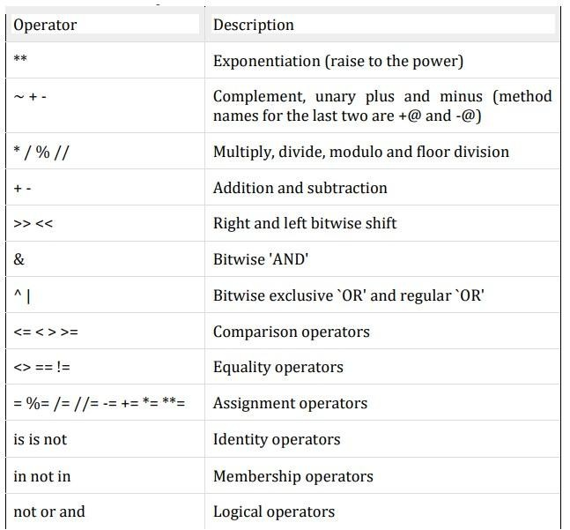
Operator Precedence
Highest
Lowest

Slide 18
Exercise 2
Evaluate the following.
a. 16*20+4
b. 102-41//6
c. 20.0*12.0-4
d. 9.2*54**4
e. 9%5
f. 2**12+4+23-7%8
g. 124//8*6+234
h. 5**6+9-12

Slide 19
Any Questions?
HAVE A NICE DAY!

